Slide 1
PTA OPEN MEETING
Smith Magnet Elementary School
Quarter 2

Slide 2
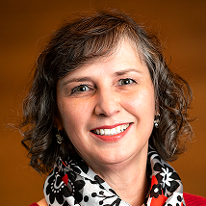
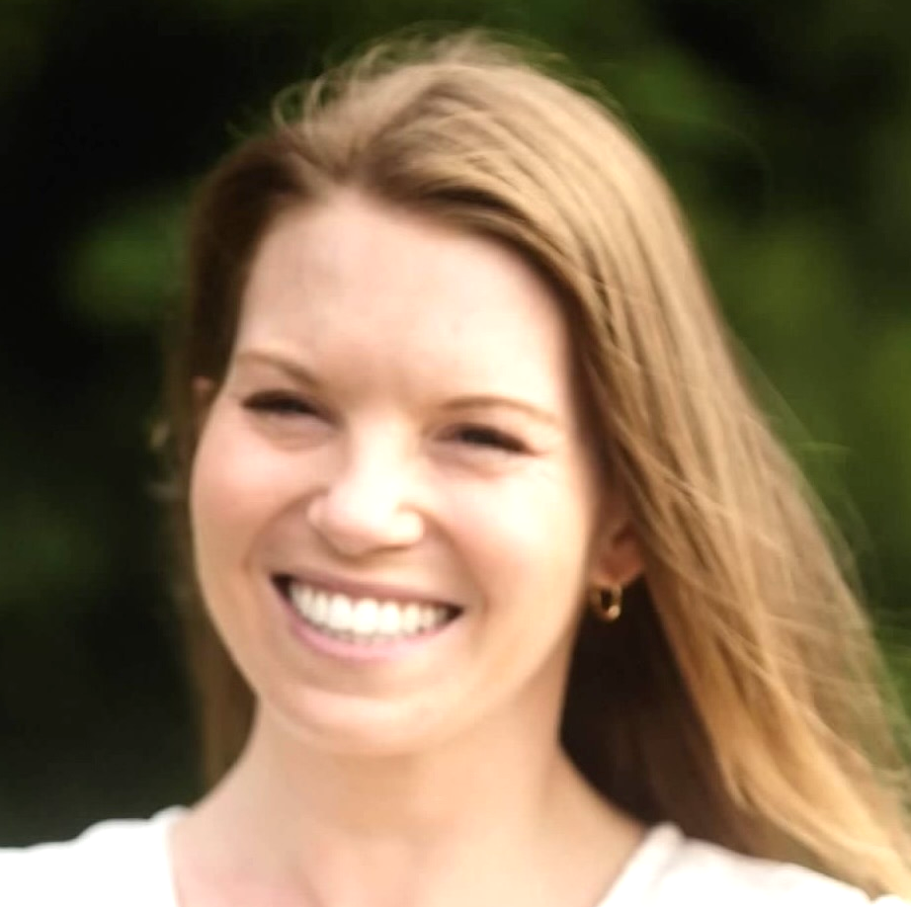
INTRODUCTIONS
Shraddha Shapariya - PTA President
shraddha@shapariya.com
Mary Cole Pike - PTA Vice President
marycoleallen@gmail.com
Ashley Donovan - PTA Treasurer
ashleylndsy@gmail.com
Lori Wendt - PTA Secretary
Loriwendt90@gmail.com
Beverly Smith
SMES Principal
bsmith7@wcpss.net
Tate Junis - PTA Board Member at Large
lambecat@gmail.com
Cindy Craddock - PTA Board Member at Large
cindytcraddock@gmail.com

Slide 3
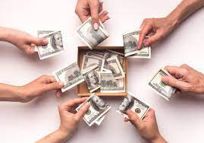
MYTH
All PTA does is collect money

Slide 4
MITO
Todo lo que hace PTA es recoger dinero.

Slide 5
REALITY
Funds are used to support various events for:
Teachers – Appreciation events
Students – Field day, Book fair, monthly Dojo cart & parties
School Community – Fall festival, Movie night
Join the PTA to know how we utilize the funds

Slide 6
REALIDAD
Los fondos son utilizados para apoyar diferentes eventos:
Maestros – Eventos de agradecimiento
Estudiantes – Salidas de campo, Feria del libro, Carro mensual de DOJO y celebraciones.
Comunidad educativa– Festival de otoño
Únete al PTA para conocer cómo se utilizan los fondos.

Slide 7
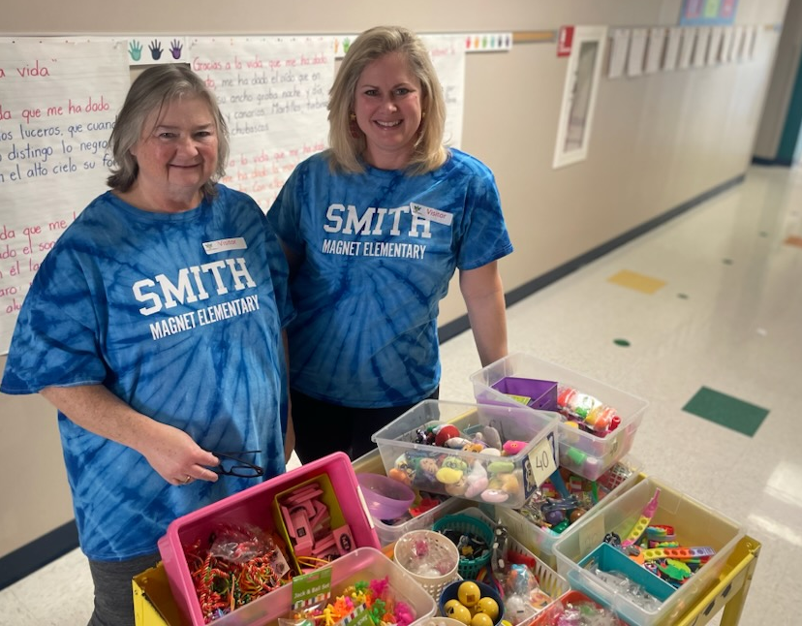
DOJO COMMITTEE
Next dojo day - Feb 2nd
You can volunteer to take the cart to each class or donate items.
Kids in grades 3-5 with more than 60 Dojo points enjoy a party!

Slide 8
DOJO CART
WISH LIST
Help us keep celebrating every month!
https://www.amazon.com/hz/wishlist/dl/invite/4nAnbA1?ref_=wl_share

Slide 9
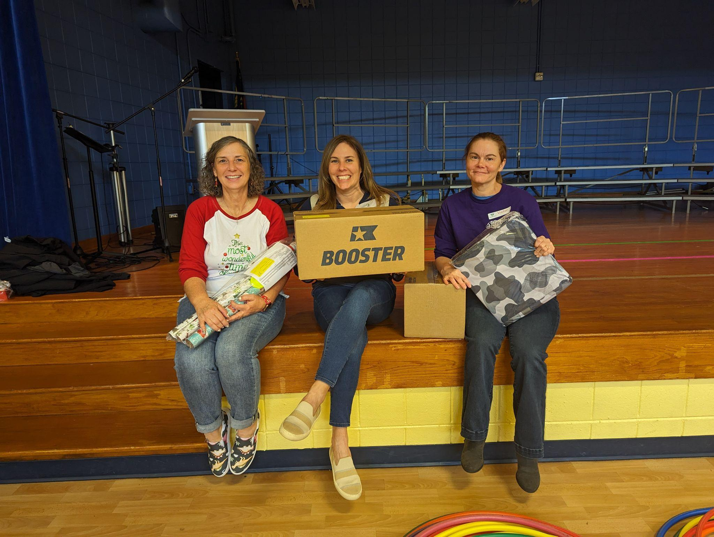
CATALOGUE FUNDRAISER
Huge success!
Thank you to volunteers!
Profit: $3,821.90

Slide 10
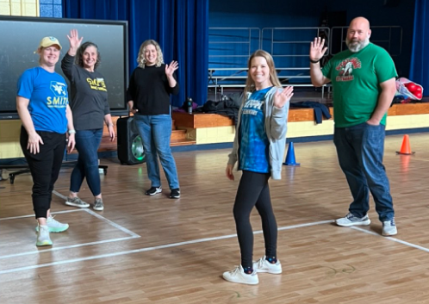
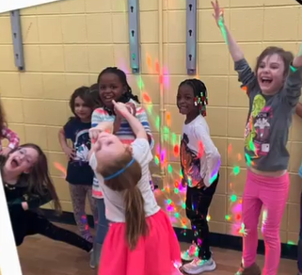
DANCE PARTY
Lessons learned
Rules/expectations outlined and sent to teachers
Loud environment - alternative activity for sensory issues or noise-reducing headphones

Slide 11
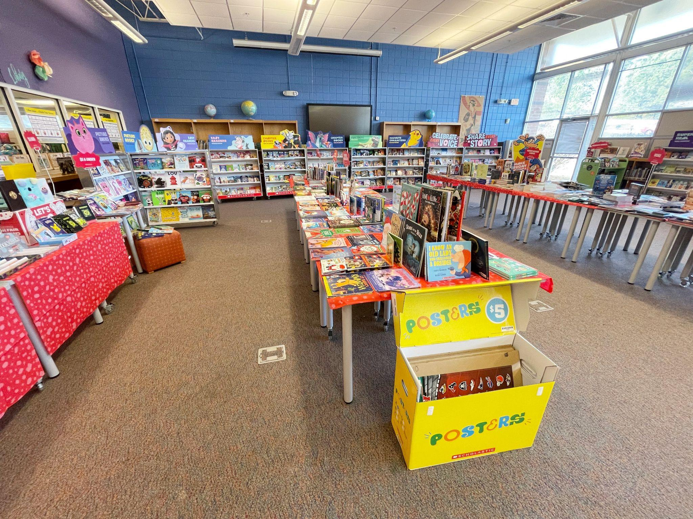
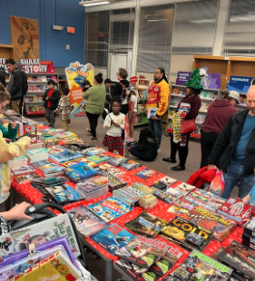
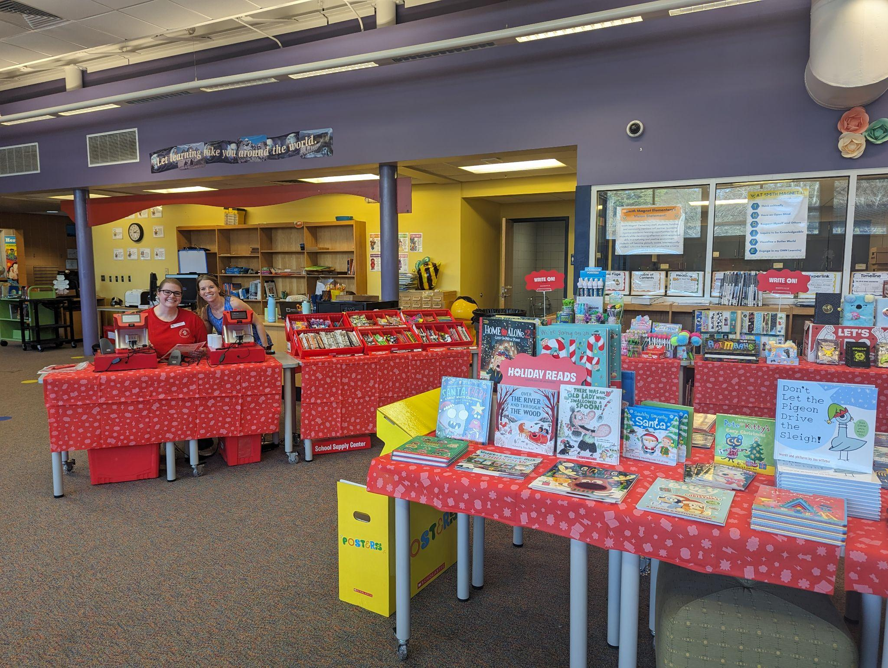
BOOK FAIR
Huge success!
Still awaiting final numbers from Scholastic to determine profit, but total sales exceeded previous year

Slide 12
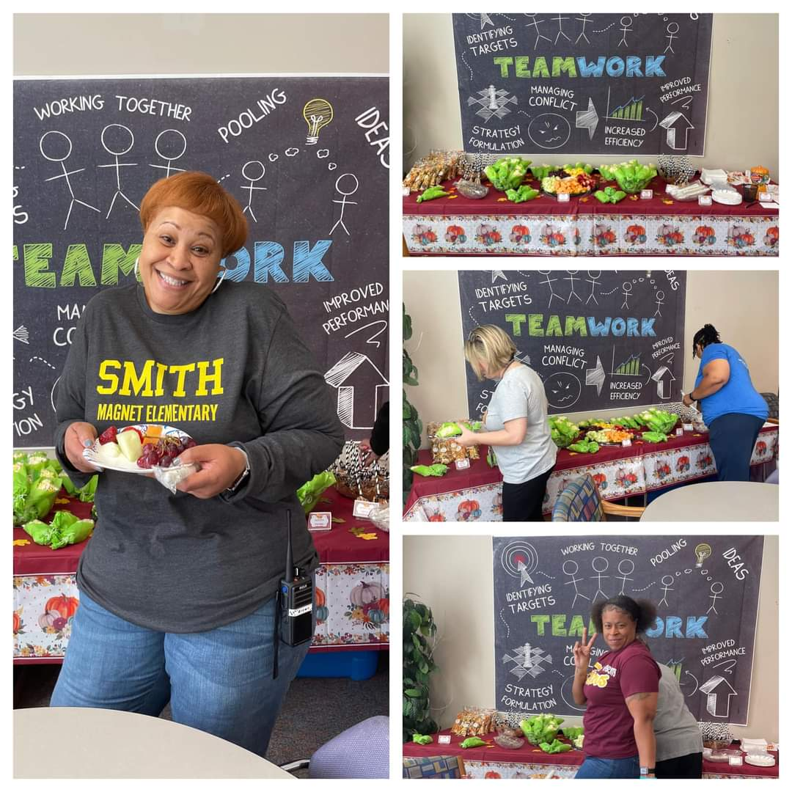
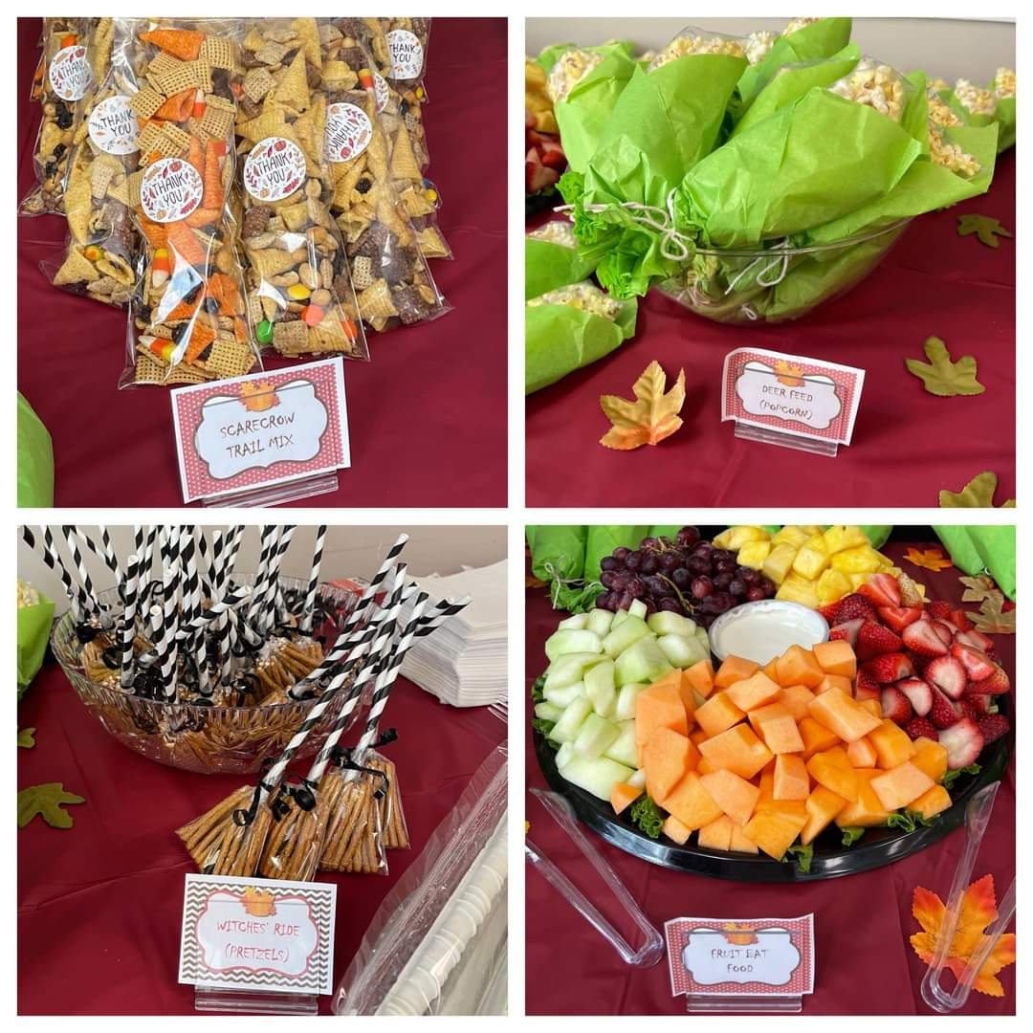
TA COMMITTEE

Slide 13
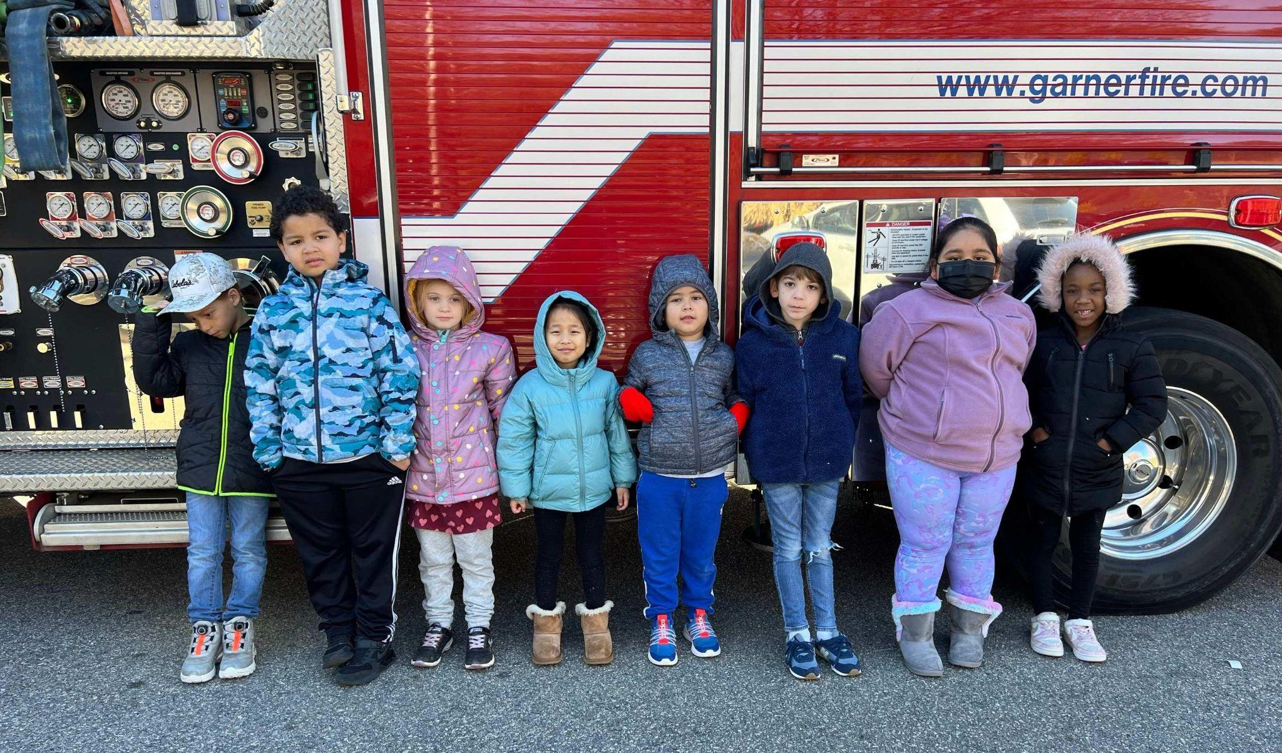
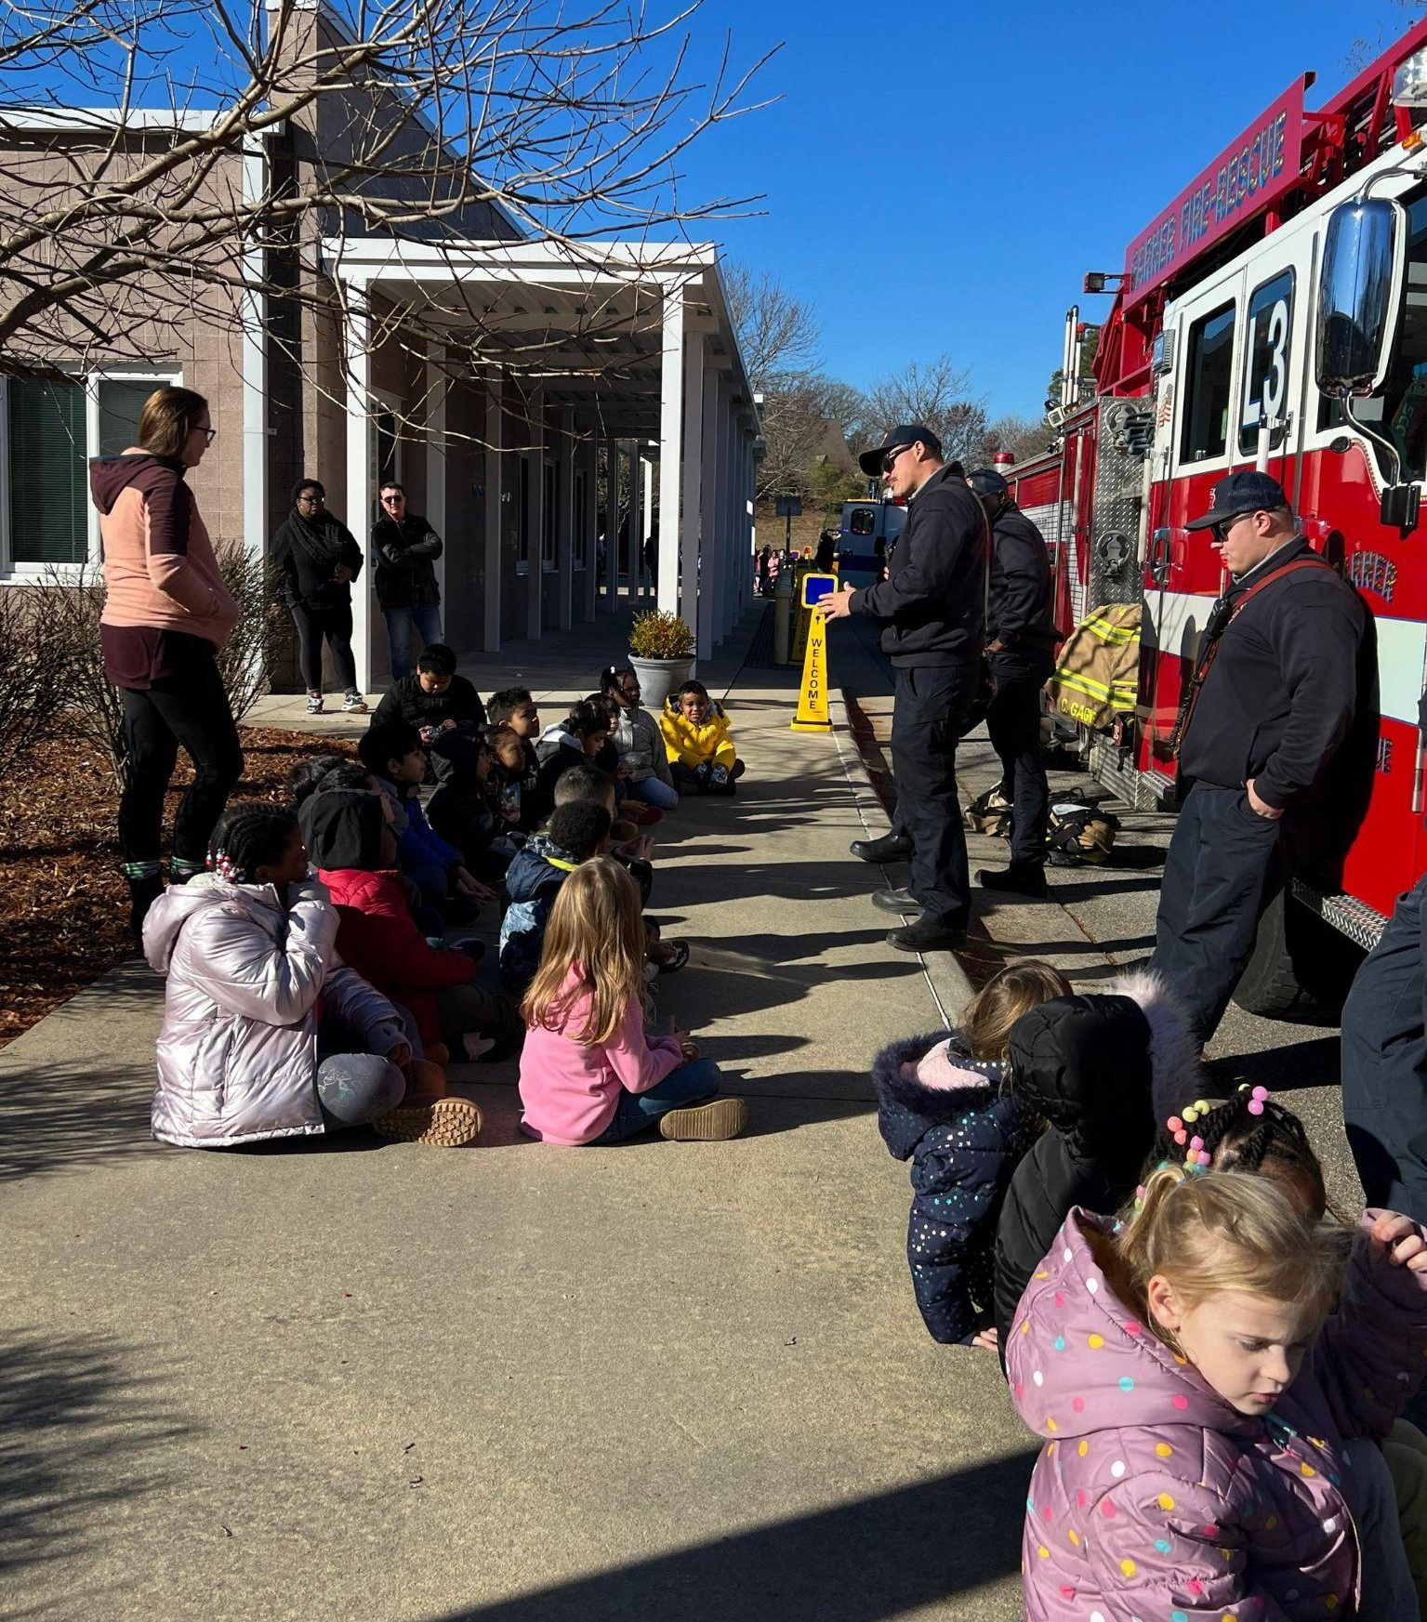
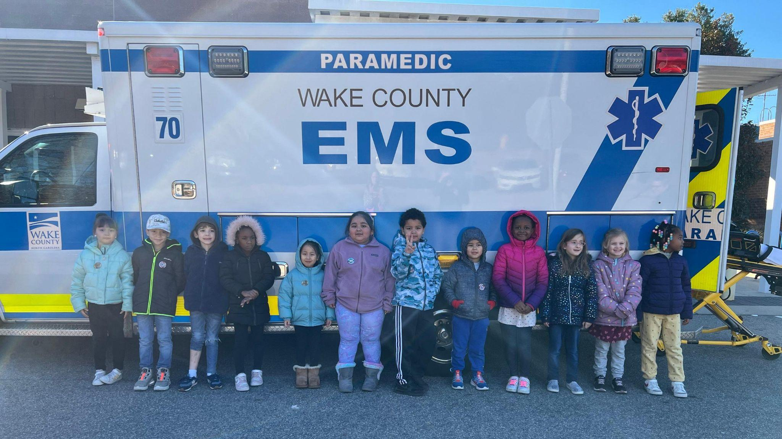
TA COMMITTEE
Fall Snacks for staff on Oct. 27 (previous slide)
Sponsored Holiday Lunch for staff from City BBQ on Dec 15
Sponsored snacks and coffee for volunteers at “Careers on Wheels” event for 1st Grade on Dec 15

Slide 14
YEARBOOK: The Bee Keeper
Student portraits have been uploaded to system by Strawbridge. Work to commence on the class pages in February.
Cover has been submitted.
Submit photos that include 2 or more students to Ashley Donovan:
919-539-6319
ashleylndsy@gmail.com

Slide 15
FUNDRAISING COMMITTEE
City BBQ is donating 20% of sales on Sat, Jan 20th between 11am - 8pm
City BBQ, February 23
Box Tops - received $23.10 in December

Slide 16
VOLUNTEERING OPPORTUNITIES
Upcoming events
Valentine’s Day staff appreciation
Movie night
Spring Book Fair (April)
Wake Up and Read book donation (May)
Tentative Field Day - May 3 (rain day of May 10)
Upcoming Dojo Fridays
February points - Friday, March 1
March points - Friday, April, 5
April points - Friday, May 3
May points - Friday, June 7

Slide 17
CONNECT WITH US
FACEBOOK
https://www.facebook.com/SmithMagnetElementaryPTA
EMAIL
smithmagnetelementarypta@gmail.com
JOIN PTA TODAY
Givebacks (memberhub.com)

Slide 18
CONÉCTATE CON NOSOTROS
FACEBOOK
https://www.facebook.com/SmithMagnetElementaryPTA
EMAIL
smithmagnetelementarypta@gmail.com
ÚNETE AL PTA HOY
Givebacks (memberhub.com)

